Slide 1

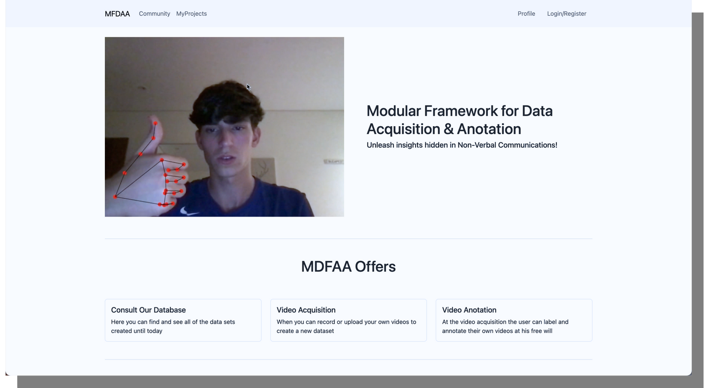
MFDAA
Modular Framework for Data Acquisition and Annotation (MFDAA)
Authors:
Pedro Durval nº 103173
João Afonso nº 103037
Eduardo Fernandes nº 102648

Slide 2
Context & Goals
Methodology
Personas & Scenarios
Conceptual Model
Tasks
Requirement Analysis
Low-Fidelity Prototype
Prototype Evaluation
Changes under the influence of users feedback
Technologies
Live Demo
Future Work
Index

Slide 3

Context
The process of gathering data that fits user specifications for whatever goal it may be is a boring, time and resource consuming process
The world's exponencial growth in technology has created a bigger pool of stakeholders that look to integrate user interactive features in their systems
A stand-out characteristic of the tech community is its will to make past struggles easy to overcome by publishing present solutions that can be used by future third-parties
Designed for researchers and developers of Human Computer Interaction technology
Related to our PECI project

Slide 4

Goals
Provide a modular framework for creating datasets that supports acquisition, annotation, and training of data from videos.
Enable the study of nonverbal cues in human-computer interaction by providing a systematic approach to data acquisition and annotation.
Support the development of machine learning approaches for interaction scenarios, such as gesture detection and human action recognition.

Slide 5
Main Goal
Create a modular platform that allows users to acquire, annotate and visualize data as well as their features

Slide 6
Methodology
User-Centered Development
Weekly Sprints
Iterative methodology;
The weekly discussions helped the team stay on pace and determine what the next steps should be;
The backlog was also always updated with new tasks from each sprint (JIRA SOFTWARE).
Designed to fit the view of the stakeholders and improved through time;
Constructed with the established goals in mind.

Slide 7
User Interaction
Persona
Scenario
João Alves, 25, Phd student at Universidade de Aveiro
Conducting a study about the impact of facial expressions in the interpretation of feelings
Having difficulties finding an easy way to record large quantities of videos to use in his study
Enter the platform
Create a new project
Set intended recording specifications and labels
Use the framework's automative capabilities to easily and effectively grow the project

Slide 8
User Interaction
Persona
Scenario
Bradley Henderson, 34, developer at a young San Francisco tech company
Looking to improve the accessibility off his mobile app
Attempting to tackle challenges caused by diseases such as Parkinson
Creating an AI gesture recognition model
Struggling to find datasets suitable enough to train his model
Enter the platform
Browse through public projects
Select a suitable project
Check content and edit or delete it if need be
Visualize the analysis
Scale up the process by adding more contributors

Slide 9
Tasks
Search what MFDAA has to offer and its mission
Change the class of the video you wish to associate to future recording
Record video(s)
Change recording(s) name(s) / label(s)
Change recording(s) class(es)
Predict where the video will be displayed after being sent to DB
Delete video(s)
Go to the page that predict what gesture you are trying to do
Go to Profile and Delete Account
Browse on DB

Slide 10

Functional
Requirements
Non-functional
Requirements
Data Acquisition: The platform should be able to capture video data inside the framework and import from various sources.
Annotation and Labeling: should provide to users an intuitive approach for labeling and annotating videos.
Allow colaboration between users by allowing projects to be public and expandable with export and import features.
Visualization of analysis processes
Performance and Scalability, framework should be efficient and scalable to handle large video datasets.
User-Friendly Interface
Reliability, platform should perform accurately and consistently without errors or failures.
Accessibility and Compatibility with different browsers and systems

Slide 11
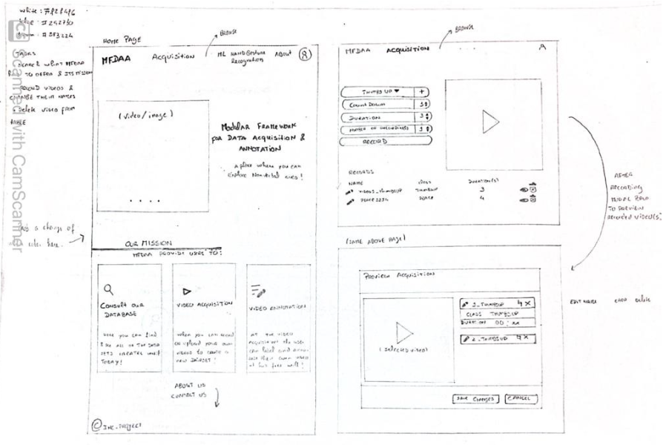
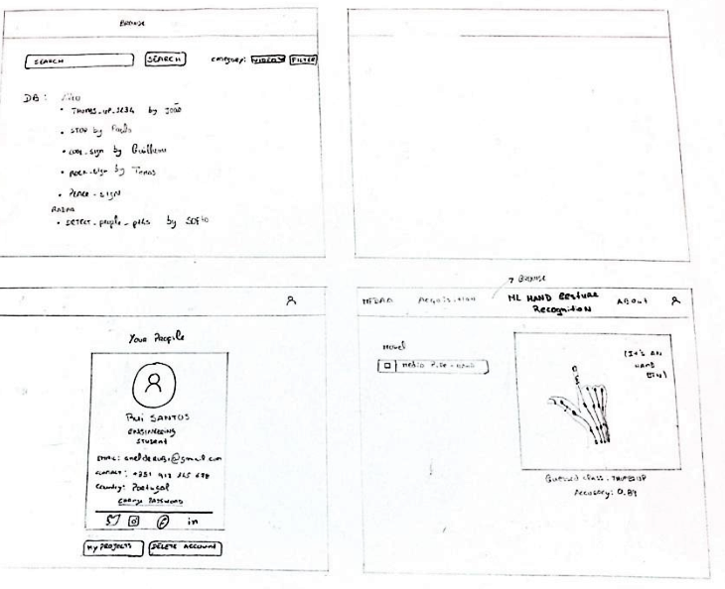
Low-Fidelity Prototype
In the early stages, we developed a Low-Fidelity prototype
User Test Prototype

Slide 12
Evaluate the MFDAA app prototype (WORFKFLOW)
Search for users to test our app prototype.
A brief explanation was given to the user about what our application consists of.
The user was given a consent form to be signed after careful reading.
The tasks that the user must perform were announced in order to evaluate their difficulty of execution.
It was necessary to use a timer so that the app's founder could determine the execution time of each task.
Another team member counted the clicks necessary to complete each task and evaluated the ease of each task on a scale of 0-5.
Finally, each user was presented with the System Usability Scale (SUS) questionnaire.

Slide 13
Development Validation
 | Tester 1 (DETI) | Tester 2 (Researcher) | Tester 3 (Researcher) | Tester 4 (Outside IT)
I think that I would like to use this system frequently. | Totally agree | Somewhat agree | Neutral | Somewhat agree
I found the system unnecessarily complex. | Somewhat disagree | Somewhat disagree | Somewhat disagree | Tottaly disagree
I thought the system was easy to use | Totally agree | Somewhat agree | Neutral | Neutral
I found the various functions in this system were well integrated | Neutral | Somewhat agree | Somewhat agree | Somewhat agree
I would imagine that most people would learn to use this system very quickly | Agree | Agree | Somewhat Agree | Somewhat Agree
15 USER TESTS
Profile: 10/15 - DETI students (18-23 years old); 2/5 - Researchers (45-60); 3/5 - Students outside IT Area (19-25)
Tasks were created for people to test out our interface;
The outcome was useful, we were able to make the changes needed in our interface to make it more intuitive.

Slide 14
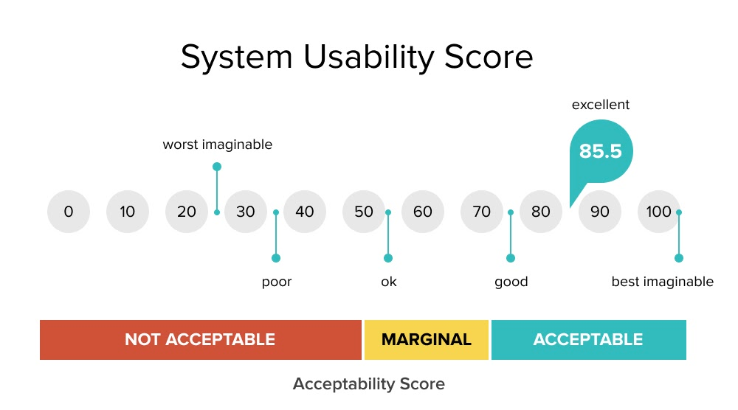
System Usability Scale (SUS)
Industry standard to validate interface
Average SUS score: 68

Slide 15
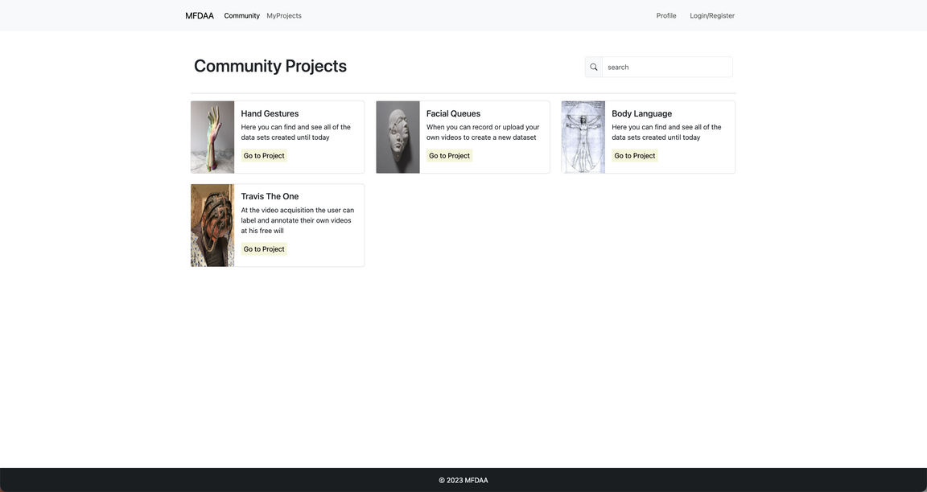
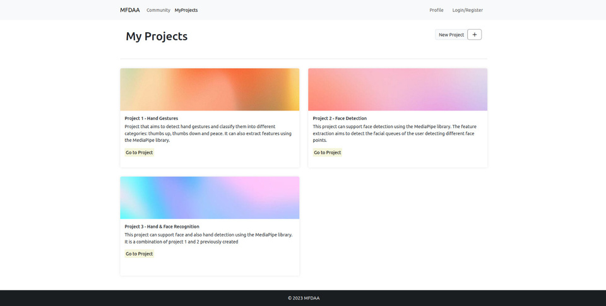

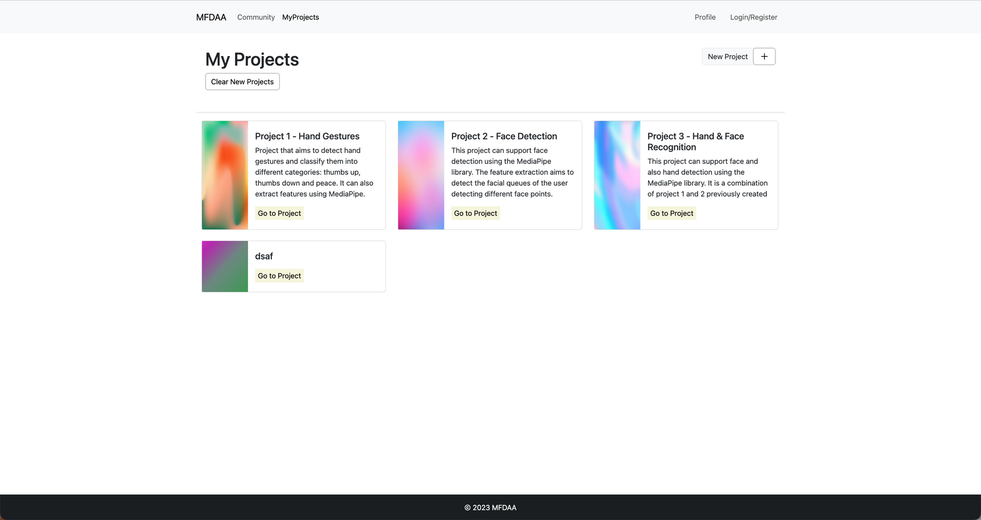
Changes made by User's feedback - Projects
Community Projects and My Project both represent projects;
Both pages should have the same projects design;

Slide 16
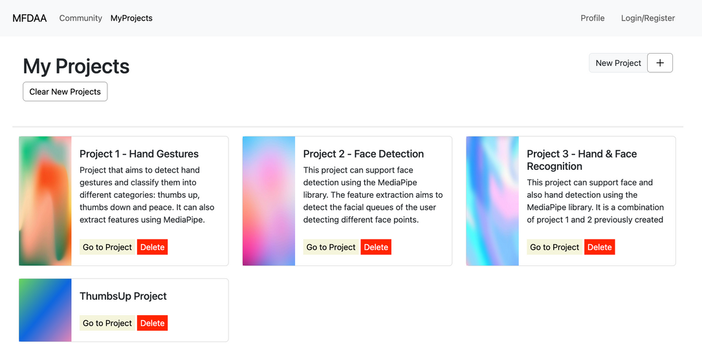
Changes made by User's feedback - Delete Button
Users also reported that each project should have a delete button

Slide 17


Technologies
SVELTE
JAVASCRIPT

Slide 18
What about the team's work?
Learn and adapt to new technologies (svelte) that were unfamiliar to us.
Our team recognized the importance of embracing change and expanding our skills to overcome this challenge.
This process not only improved our abilities but also provided us with greater flexibility and efficiency in executing project tasks.
Notes:
During the project, we had to learn and adapt to new technologies (svelte) that were unfamiliar to us. Our team recognized the importance of embracing change and expanding our skills to overcome this challenge. This process not only improved our abilities but also provided us with greater flexibility and efficiency in executing project tasks. We now stand equipped with a broader skillset and a commitment to staying innovative.

Slide 19
Live Demo
MFDAA

Slide 20
Final Product Validation
 | Tester 1 (DETI) | Tester 2 (Researcher) | Tester 3 (Researcher) | Tester 4 (Outside IT)
I think that I would like to use this system frequently. | Somewhat agree | Somewhat agree | Neutral | Somewhat agree
I found the system unnecessarily complex. | Somewhat disagree | Somewhat disagree | Somewhat disagree | Tottaly disagree
I thought the system was easy to use | Totally agree | Somewhat agree | Totally agree | Somewhat agree
I found the various functions in this system were well integrated | Somewhat agree | Somewhat agree | Somewhat agree | Totally agree
I would imagine that most people would learn to use this system very quickly | Totally Agree | Totally Agree | Somewhat Agree | Somewhat Agree
8 USER TESTS
Profile: 5/8 - ECT students (18-23 years old); 1/8 - Researchers (51 years old); 2/8 - Students outside IT Area (20-25 years old)
Same evaluation but different results with changes from user's feedback

Slide 21
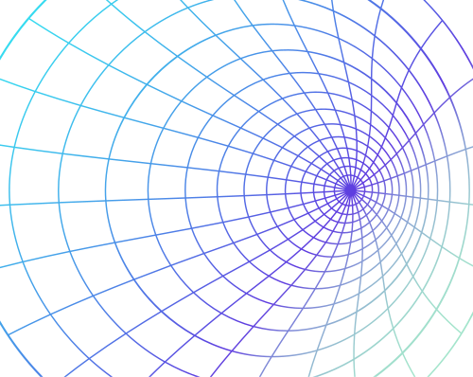
Future Work
Allow for the processing of video data may be useable for feature extraction instead of being just only in real time
Improve efficiency, accuracy and variety of our data analysis classes
The ecosystem of our framework can be improved by adding more MediaPipe functions (face, facemesh)

Slide 22
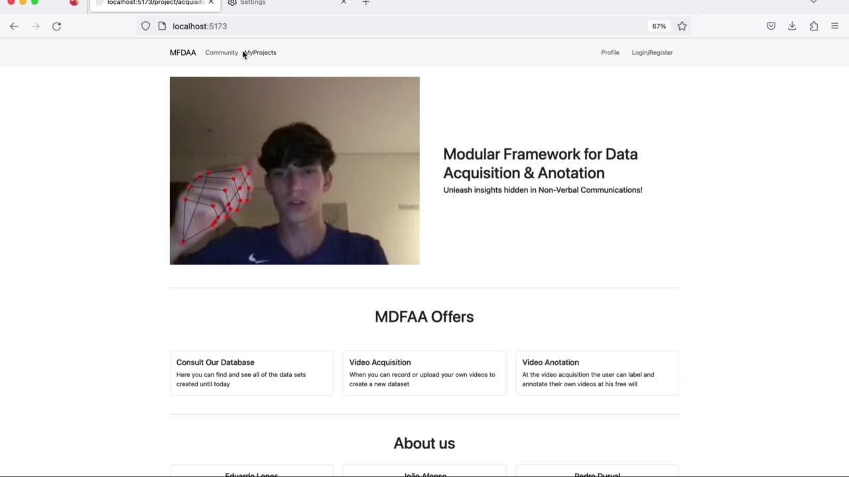
Any questions?

